Slide 1

AWS CLOUD ARCHITECTURE SERIES
Mastering Amazon SQS
Decoupling Distributed Systems with High-Performance, Serverless Message Queuing.

Slide 2

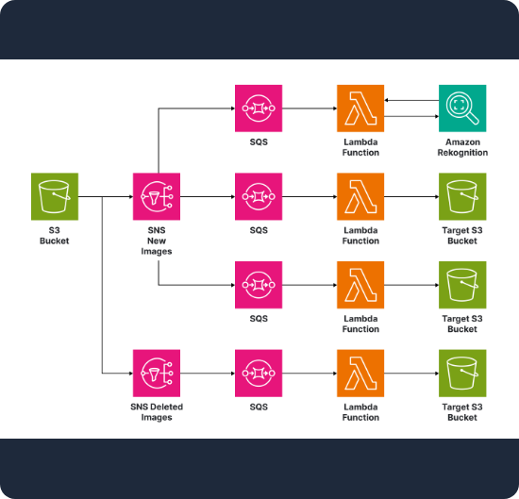
WHAT IS AWS SQS?
A Pioneer Service
AWS Simple Queue Service (SQS) was the first service ever launched by AWS in 2004.
It is a fully managed, durable message queuing service that enables you to decouple and scale microservices, distributed systems, and serverless applications.
No infrastructure to manage
Automatic scaling
Highly available and durable

Slide 3






CORE BENEFITS
Decoupling
Elasticity
Reliability
Allows components to work independently. A failure in the consumer doesn't block the producer.
Handles spikes in traffic by buffering messages. Scale from zero to billions of messages instantly.
Messages are stored across multiple Availability Zones (AZs) to prevent data loss.

Slide 4

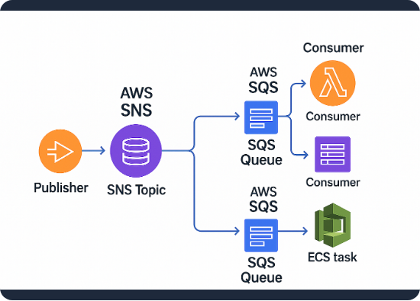
ARCHITECTURE OVERVIEW
The Producer-Consumer Pattern
1. Producers send messages to the queue.
2. Messages are stored redundantly in the SQS cluster.
3. Consumers poll the queue to retrieve and process messages.
4. After successful processing, the consumer deletes the message to prevent re-processing.

Slide 5

STANDARD QUEUES
Default Choice
Standard queues offer maximum throughput and best-effort ordering.
Unlimited Throughput: Scales to nearly infinite TPS.
At-Least-Once Delivery: A message is delivered at least once, but occasionally more than one copy is delivered.
Best-Effort Ordering: Messages usually leave in the same order they arrived, but no guarantee.

Slide 6

FIFO QUEUES
Order Matters
First-In-First-Out (FIFO) queues are designed for applications where order and deduplication are critical.
Strict Ordering: The order in which messages are sent and received is strictly preserved.
Exactly-Once Processing: Prevents duplicate messages from being processed.
High Throughput: Up to 3,000 req/s with batching.

Slide 7
COMPARISON: STANDARD VS FIFO
Feature | Standard Queue | FIFO Queue
Throughput | Unlimited | 300 TPS (Standard) / 3,000 (Batch)
Delivery | At-Least-Once | Exactly-Once
Ordering | Best-Effort | First-In-First-Out (Strict)
Use Case | Decoupling, batching, notifications | Banking, ticketing, sequence-sensitive tasks

Slide 8




THE MESSAGE LIFECYCLE
Send
Poll
Process
Delete
Producer sends message to SQS endpoint.
Consumer retrieves message from queue.
Message is hidden (Visibility Timeout).
Consumer deletes message upon success.

Slide 9
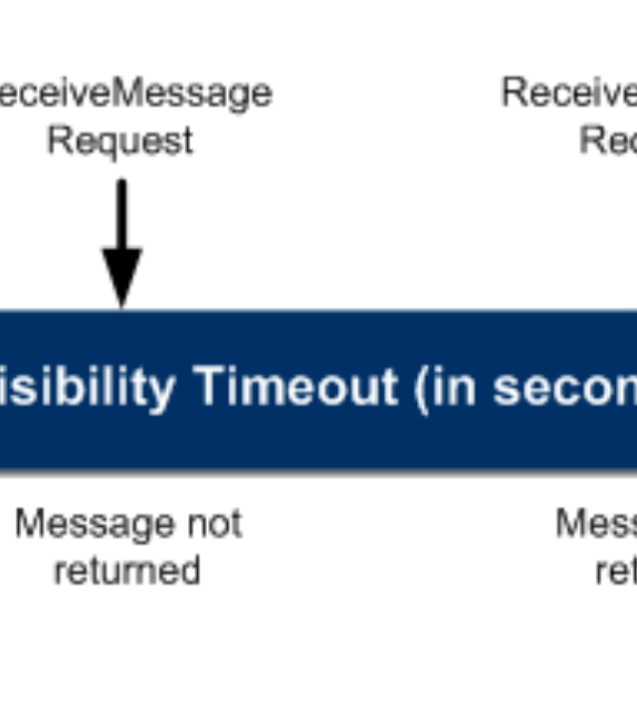
VISIBILITY TIMEOUT
When a consumer receives a message, it stays in the queue but is hidden from other consumers for a set period.
This prevents other consumers from processing the same message simultaneously.
Default: 30 seconds
Max: 12 hours

Slide 10






DEAD LETTER QUEUES (DLQ)
Error Handling
Debugging
Redrive Policy
A DLQ is a sub-queue used to store messages that can't be processed after multiple attempts.
Allows developers to inspect "poison messages" without blocking the main workflow.
Defines the maxReceiveCount before a message is moved to the DLQ.

Slide 11
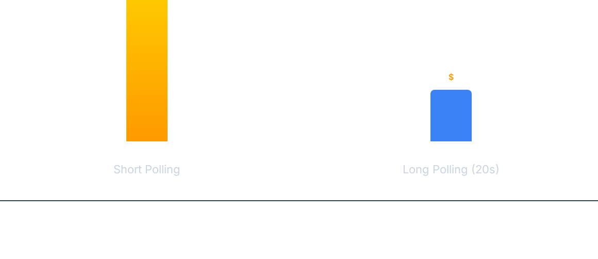
SHORT POLLING VS LONG POLLING
Long Polling reduces costs and empty responses by waiting for messages to arrive before responding.

Slide 12
DELAY QUEUES & TIMERS
15
0
MINS MAX DELAY
DEFAULT DELAY
Postpone the delivery of messages to consumers. Use Delay Queues for the whole queue or Message Timers for individual messages.

Slide 13

BATCHING FOR EFFICIENCY
Maximize Performance
Reduce costs and API calls by batching operations.
SendMessageBatch: Send up to 10 messages in one call.
COST SAVINGS: UP TO 90%
ReceiveMessage: Fetch up to 10 messages (Max 256KB total).
By utilizing batching vs individual calls.
DeleteMessageBatch: Delete multiple messages simultaneously.

Slide 14


SECURITY & ENCRYPTION
Enterprise Security
IAM Integration: Use AWS IAM policies to control who can send or receive.
SSE (Server Side Encryption): Protect data at rest with AWS KMS.
VPC Endpoints: Access SQS without traversing the public internet via AWS PrivateLink.

Slide 15
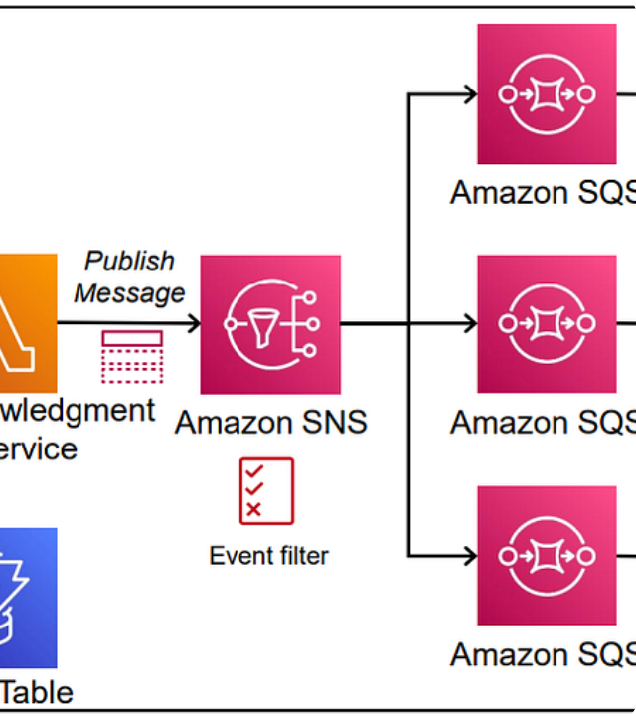
SQS + LAMBDA
The ultimate serverless combo. AWS Lambda automatically polls SQS queues and scales based on message volume.
Zero management overhead.
Automatic retry logic.
Cost-effective execution.

Slide 16
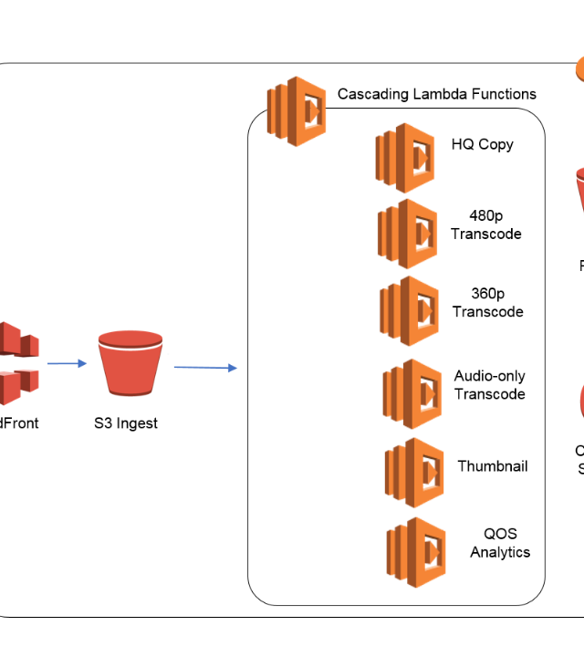
FAN-OUT PATTERN
Combine SNS and SQS to broadcast messages to multiple consumers.
When a message is published to an SNS topic, it is distributed to multiple SQS queues for parallel processing.
Perfect for logging, analytics, and complex workflows.

Slide 17



COMMON USE CASES
E-Commerce
Video Encoding
IoT Telemetry
Handling order placement, inventory updates, and confirmation emails.
Buffering high-volume upload tasks for batch processing workers.
Ingesting massive streams of sensor data for downstream analysis.

Slide 18


CLOUDWATCH MONITORING
Essential Metrics
Track the health of your queues with CloudWatch:
ApproximateNumberOfMessagesVisible: Is the queue growing too fast?
SentMessageSize: Monitor message payloads.
NumberOfMessagesDeleted: Track successful processing.

Slide 19
BEST PRACTICES
Enable Long Polling: Always set WaitTimeSeconds > 0 to save money.
Use DLQs: Always handle failures gracefully.
Optimize Visibility Timeout: Ensure it's longer than your max processing time.
Batch Operations: Group messages to reduce API overhead.
Deduplication (FIFO): Use MessageDeduplicationId for exactly-once.

